Slide 1

International Trade Issues, Part 1
Amanda Hodges, Ph.D.
Entomology/Nematology Dept.
University of Florida
Exotic Species & Biosecurity Issues ENY 4161/6166

Slide 2
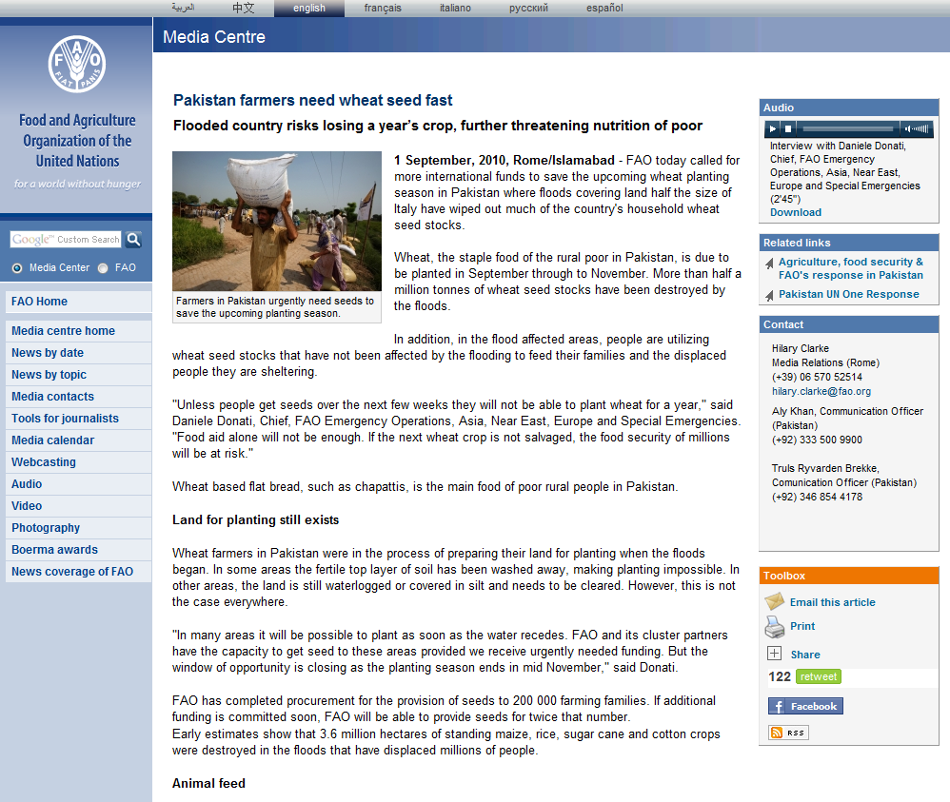
Pakistan-Food Security Issues
Website: http://www.fao.org/news/story/en/item/45027/icode/

Slide 3
Objectives
Terminology and Trade Concepts
Case Studies

Slide 4
Terminology and Trade Concepts
International Monetary Fund (IMF): oversees currency exchange policies
World Bank: grants loans to developing countries
International Trade Organization (ITO): establishing and enforces multilateral trade rules.
Notes:
The following concepts began materializing following WWII, and the U.S. and Western Europe sought to promote free trade. These items were discussed in New Hampshire in 1944, but the ITO never materialized. The U.S. was concerned that the ITO would interfere with its ability to operate as an independent, sovereign nation.

Slide 5
Terminology and Trade Concepts
Eighth GATT round (1986-1994), Uruguay round
  Significant flexibility was provided to member nations in terms of restricting imports to protect human, animal, or plant life prior to this conference.
  Protection was available under GATT Article XX(b) which provided for exceptions under GATT obligation.
Notes:
Although GATT article XX(b) exception prohibited members from arbitrary discrimination against importers, no guidelines were available. GATT members could effectively restrict imports based on health and safety concerns while providing little, if any scientific support for their assumptions.

Slide 6
GATT Process-Key Questions
Does the SPS measure violate national treatment?
Is the restriction qualified as an exception?

Slide 7
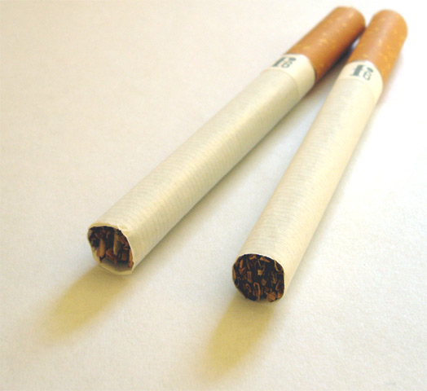
Example GATT Case Challenge
Thailand banned cigarettes from importers due to health concerns.
Photo Credit: http://en.wikipedia.org/wiki/File:Zwei_zigaretten.jpg

Slide 8
Terminology and Trade Concepts
North American Free Trade Agreement (NAFTA)
World Trade Organization (WTO)
Sanitary and Phytosanitary Measures (SPS)
What is a “necessary” restriction?

Slide 9
Terminology and Trade Concepts
NAFTA/SPS
WTO/SPS-applies to 153 WTO member countries (2008)
An attempt to balance ‘sovereign prerogative for self protection’ and eliminate ‘disguised protectionist restrictions’
Notes:
U.S. negotiators emphasized the importance of basing SPS restrictions on sound science. ‘Sound science’ has been an emphasis and considered a new element of focus for the WTO. The meaning of the laws is largely determined by the interpretation of legal case studies. The focus of case studies for this presentation follows your textbook reading assignment and is focused on the WTO/SPS agreement. WTO Appellate Body interprets issues with the WTO/SPS agreement.

Slide 10
Terminology and Trade Concepts
WTO members replaced GATT Article XX(b) defense for health and safety measures with a SPS code
WTO/SPS agreement doesn’t create SPS standards, but provides rules for adoption.
Disputes settled by WTO Appellate Body

Slide 11
SPS Agreement, Article 2.3
Members shall ensure that their sanitary and phytosanitary measures do not arbitrarily or unjustifiably discriminate between Members where identical or similar conditions prevail, including between their own territory and that of other Members. Sanitary and phytosanitary measure shall not be applied in a manner which would constitute a disguised restriction on international trade.

Slide 12
Terminology and Trade Concepts
Risk Assessment: a scientific-based justification for a higher level of protection.
Temporary SPS measure: may be adopted if little scientific evidence is available but other conditions are met.
Notes:
Members must also ensure that measures are not more restrictive than necessary in order to achieve appropriate phytosanitary results.

Slide 13
Terminology and Trade Concepts
Equivalency: Importing SPS members must accept SPS measures of exporting members who seek the same level of protection, even if by different means.
Transparency: a member must provide information to other WTO members on their SPS measures.
Notes:
Part of WTO/SPS requirements. A time period for public comment is a key component to transparency. If no international standards, must be published to the WTO Secretarist as an “early stage”. A member is also to publish notice of an intended measure before it is actually enacted.

Slide 14
Compliance with WTO/SPS
Must conform to the international standard, if any, or be able to scientifically justify the measure through a risk assessment (Harmonization)
May be temporarily adopted, although it would not qualify as a permanent measure, only as provided by the WTO/SPS
Notes:
Congress allows states to enact their own SPS laws that are not in conflict with federal laws. State laws can be more restrictive than federal laws, but proper justification must be provided. Federal and state efforts must be coordinated well in order to avoid problems with transparency.

Slide 15
Compliance with WTO/SPS
Must avoid arbitrary or unjustified distinctions in levels of protection.
Be no more trade restrictive than necessary to achieve the appropriate level of protection.

Slide 16
Compliance with WTO/SPS
Accept an exporting member’s SPS measure as equivalent if that member objectively demonstrates that its measures achieve the same level of protection.
Take into account the level of prevalence of specific diseases or pests, existence of eradication or control programs.

Slide 17
Compliance with WTO/SPS
Notify other members of changes in their SPS measures.
May not be applied through the control, inspection, and approval procedures to limit arbitrarily or unjustifiably the importation of foreign products.

Slide 18
Terminology and Trade Concepts
The World Organization for Animal Health (OIE)
The International Plant Protection Convention (IPPC)
Codex Alimenterius Commission (Codex)
Notes:
Member not using international standard must explain why in detail.
All of these organizations are recognized by WTO
OIE-established in 1924, 176 member countries in 2010
IPPC-established in 1952, 173 member countries
Codex, created by FAO and WHO in 1963

Slide 19
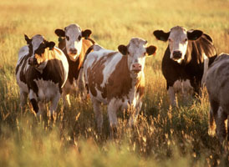
EC Beef Hormone Case Study
Late 1980s EC banned hormone-treated meat product imports.
U.S. argued that ban violated article 3.1 of the SPS agreement and ban was not based on international standard.
Photo Credit: Keith Weller
USDA ARS Photo Gallery
http://www.ars.usda.gov/is/graphics/photos/
Notes:
The Appellate Body upheld that the SPS agreement does not require a WTO member to base its SPS measures upon international standards, but must be based on risk assessment as described in article 5.1.

Slide 20
EC Beef Hormone Case Study
EC argued that the “precautionary principle” should allow them to ban beef with hormones even if scientific proof was not available.
WTO Appellate Body disagreed stating that “the precautionary principle has not been written into the SPS Agreement as a ground for justifying SPS measures that are otherwise inconsistent with the Agreement.

Slide 21

Australia’s Fresh, Chilled, and Frozen Canadian Salmon Ban
No OIE standards for the 24 diseases of concern to Australia
Australia was in violation of Articles 2.2 and 5.1-no risk assessment
Photo Credit: Troutlodge, Inc.
USDA-ARS Photo Gallery
http://www.ars.usda.gov/is/graphics/photos/

Slide 22
Australia’s Fresh, Chilled, and Frozen Canadian Salmon Ban
Established policies for risk assessment
  Identify the Disease and potential biological and economic impact.
  Evaluate the potential for entry, establishment, and spread.
  Evaluate entry, establishment, and spread in the context of the potential proposed SPS measures.

Slide 23
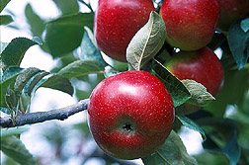
Restrictions on
U.S. Apples and Apricots
1997
Japan concerned over introduction of codling moth, and would only import red delicious apples.
Photo Credit: Peggy Greg
USDA-ARS Photo Gallery
http://www.ars.usda.gov/is/graphics/photos/
Notes:
U.S. apples had been treated with the appropriate procedures-methyl bromide + cold storage, but the U.S. had not definitely looked at various varieties of apples. As each individual variety was not evaluatJed, Japan would only accept the red delicious apples. However, Japan did not specifically refer to the variety of apple in their risk assessment. Also, refused entry of apricots. After about 10 years of negotiations, Japan never provided the appopriate ‘sound science’ risk assessment to justify stopping shipment.

Slide 24
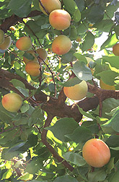
Restrictions on
U.S. Apples and Apricots
After about 10 years, the issue was finally resolved.
Photo Credit: Craig Ledbetter
USDA-ARS Photo Gallery
http://www.ars.usda.gov/is/graphics/photos/
Notes:
U.S. apples had been treated with the appropriate procedures-methyl bromide + cold storage, but the U.S. had not definitely looked at various varieties of apples. As each individual variety was not evaluatJed, Japan would only accept the red delicious apples. However, Japan did not specifically refer to the variety of apple in their risk assessment. Also, refused entry of apricots. After about 10 years of negotiations, Japan never provided the appopriate ‘sound science’ risk assessment to justify stopping shipment.

Slide 25
Terminology and Trade Concepts
Agreement on Technical Barriers to Trade (TBT)
  Covers consumer and environmental concerns not covered by SPS.
  “standards”
  “technical regulations”
  “conformity assessment procedures”
  Ensures that WTO products are treated equivalently to domestic goods
Notes:
TBT employs standards to refer to the voluntary product standards. Technical regulations is the term for ‘mandatory product standards’, and conformity assessment procedures are methods for determining whether or not a product is safe. Trade restrictions must not be more than necessary in order to meet a “legitimate objective.” Examples of legitimate objectives could include national security, protecting consumer fraud, and the protection of human, animal, or plant health.
EU is particularly skeptical of genetically engineered organisms due to the fact that they have faced several major dieases: mad cow, FMD, and some microbial contamination of food. Japan, Australia, and New Zealand also have measures affecting biotechnology.

Slide 26
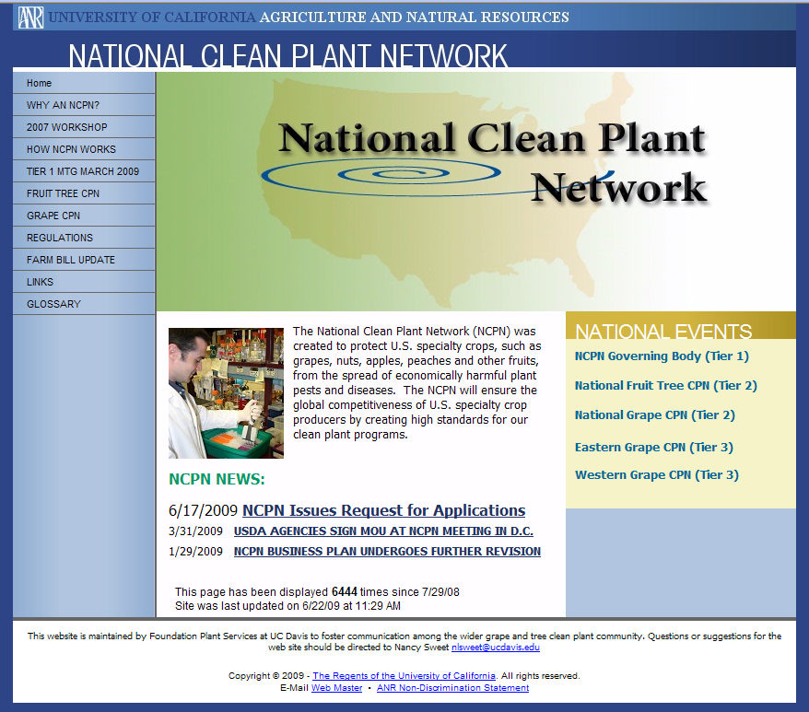
National Clean Plant Network (NCPN)
http://groups.ucanr.org/ncpn/

Slide 27
Class Discussion Topics
Should all food and feed derived from biotechnology include a biotech label? Does this concept appear to be compatible with the rules and regulations we have discussed concerning trade?
Should the U.S. conform to international standards whenever possible, or provide their own modified standards? Consider FMD and END from the text reading.

